Slide 1
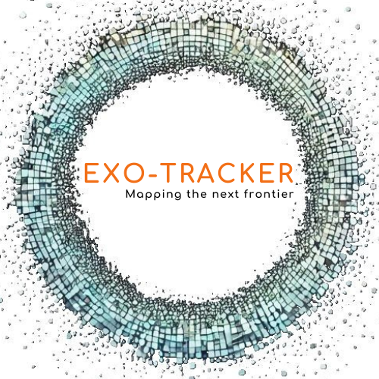
Exo-Tracker®
AI-Driven Platform for Disease Diagnosis Using Extracellular Vesicles (EVs)

Slide 2
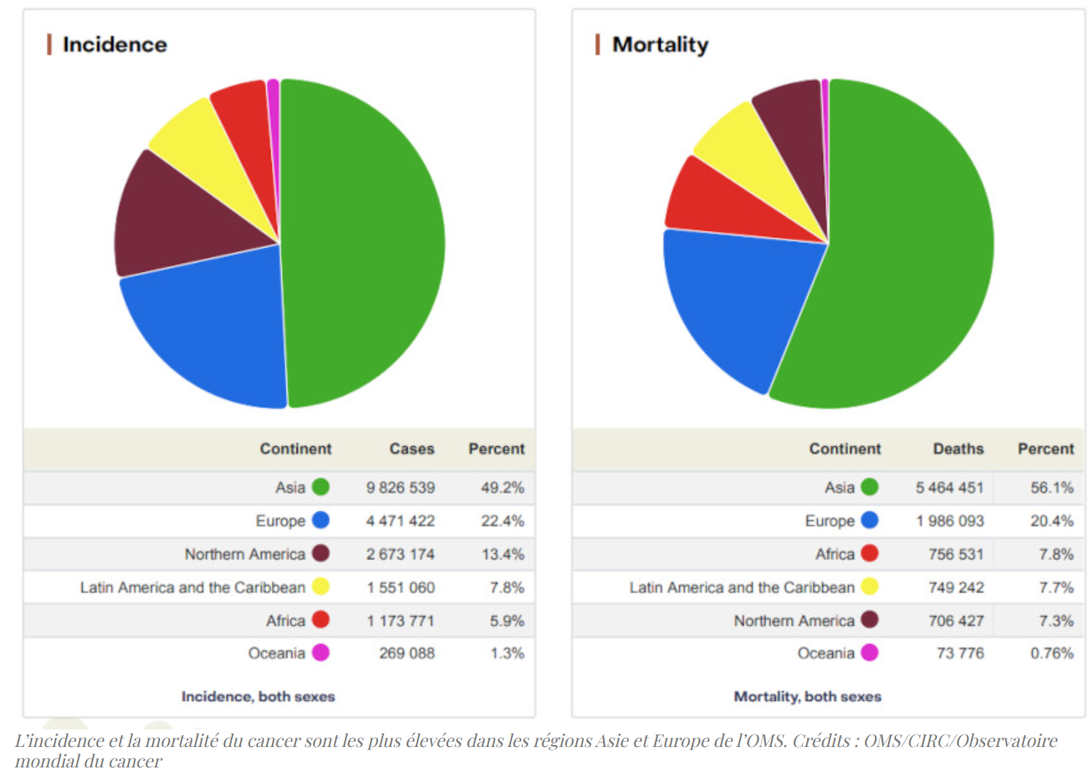
Exo-Tracker®
Our Problem
I
II
III
IV
Cancer Detection
Cancers cases doubled between 1990 and 2023 → 98% increase
Need for an early and reliable detection method
Many steps are needed to detect cancer → to much time consumed
Cancer screening often neglected by the patients because of the invasive techniques used and the difficulty of finding an appointment with a doctor
Why ?
Notes:
1) presentation of diagram and data coming from the WHO (World Health Organization) :
“The cancer burden is expected to increase by 2050. More than 35 million new cancer cases are projected by 2050, a 77% rise compared to the estimated 20 million cases in 2022. This rapid increase in the cancer burden is due to an aging and growing population, as well as changes in exposure to risk factors, sometimes linked to socioeconomic development. Tobacco, alcohol, and obesity are the main factors driving the rise in cancer incidence, while air pollution remains one of the major environmental risk factors.”
FOLLOWING WITH THE CATCH UP PHRASE
Imagine a world where diseases could be diagnosed effortlessly—using AI and simple, non-invasive biological samples like blood, urine, or saliva. Sounds incredible, right? Well, what if I told you that this future isn't far off—it's reachable right now.
At Exo-Tracker, we believe this future is already reachable. By harnessing the power of AI with the great potential of extracellular vesicles (EVs) in diagnostics application, we believe to be able to provide an in vitro diagnostic product (IVD) that will transform the future of disease detection and monitoring

Slide 3
Exo-Tracker®
Our Solution
I
II
III
IV
Extracellular Vesicles (EVs)
Artificial Intelligence (AI)
Nanoparticles
Blood, urine, saliva, breast milk…
Cargo
Data acquisition (SERS), ETL
Data → Model training
Inference : classification
Non Invasive
Diagnostic potential
AI-Driven Platform for Disease Diagnosis
Oncology
Neurodegenerative disease
Others diseases
Andre M, et al – BMC Cancer (2024)
Gurung S et al - Cell Commun Signal (2021)
1
Notes:
Before talking about the substance of the project, let me start explaining to you what are EVs.
List of Reference :
Andre M, et al – BMC Cancer (2024) : Andre M, Caobi A, Miles JS, Vashist A, Ruiz MA, Raymond AD. Diagnostic potential of exosomal extracellular vesicles in oncology. BMC Cancer. 2024 Mar 8;24(1):322. doi: 10.1186/s12885-024-11819-4. PMID: 38454346; PMCID: PMC10921614.
Gurung S et al - Cell Commun Signal (2021) : Gurung S, Perocheau D, Touramanidou L, Baruteau J. The exosome journey: from biogenesis to uptake and intracellular signalling. Cell Commun Signal. 2021 Apr 23;19(1):47. doi: 10.1186/s12964-021-00730-1. PMID: 33892745; PMCID: PMC8063428.

Slide 4
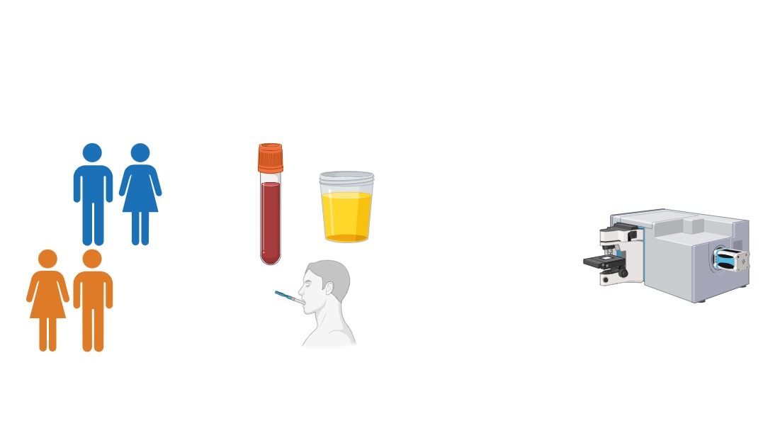
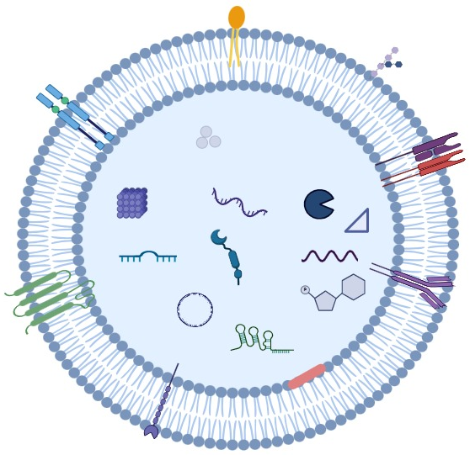
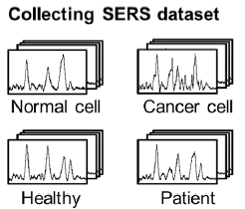
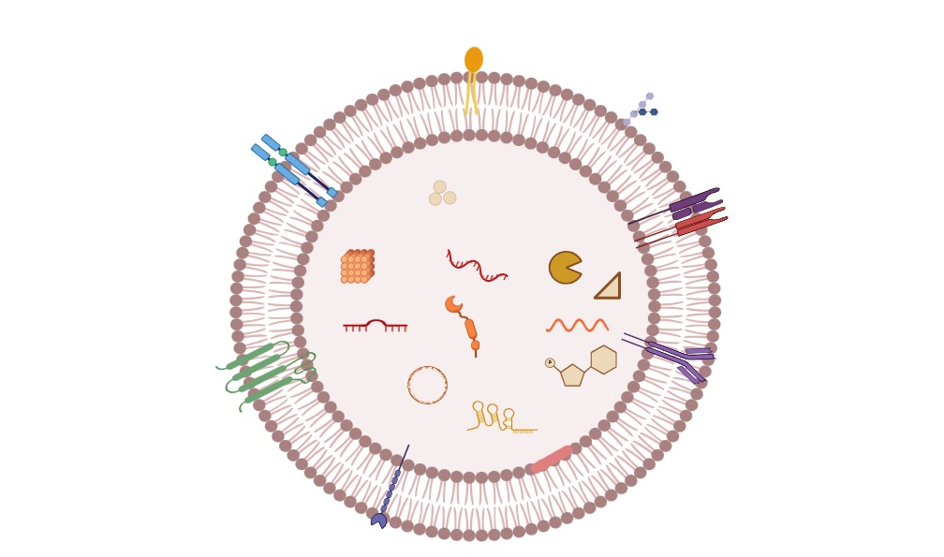


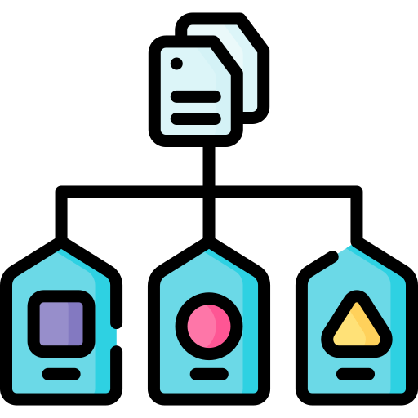
Exo-Tracker®
Our Solution
I
II
III
IV
Extracellular Vesicles (EVs)
Artificial Intelligence (AI)
Nanoparticles
Blood, urine, saliva, breast milk…
Cargo
Data acquisition (SERS), ETL
Data → Model training
Inference : classification
Non Invasive
Diagnostic potential
Extraction, Transformation & Load of data
Training the model
Surface Enhanced Raman Spectroscopy (SERS)
Ill & healthy individuals
Samples collection
EVs
AI-Driven Platform for Disease Diagnosis
Oncology
Neurodegenerative diseases
Other diseases
Andre M, et al – BMC Cancer (2024)
Gurung S et al - Cell Commun Signal (2021)
Classification
1
Notes:
Before talking about the substance of the project, let me start explaining to you what are EVs.
List of Reference :
Andre M, et al – BMC Cancer (2024) : Andre M, Caobi A, Miles JS, Vashist A, Ruiz MA, Raymond AD. Diagnostic potential of exosomal extracellular vesicles in oncology. BMC Cancer. 2024 Mar 8;24(1):322. doi: 10.1186/s12885-024-11819-4. PMID: 38454346; PMCID: PMC10921614.
Gurung S et al - Cell Commun Signal (2021) : Gurung S, Perocheau D, Touramanidou L, Baruteau J. The exosome journey: from biogenesis to uptake and intracellular signalling. Cell Commun Signal. 2021 Apr 23;19(1):47. doi: 10.1186/s12964-021-00730-1. PMID: 33892745; PMCID: PMC8063428.

Slide 5
Exo-Tracker®
Market Size : In-Vitro Diagnostic Product* (IVD)
I
II
III
IV
Global Market
(2024)
Largest Market
Size
102.16 B USD
USA
CAGR 5,20%
Global Market
(2029)
Fastest Growing Market Size
131.66 B USD
Asia/Pacific
Mordo Intelligence
FDA 21 CFR 809.3 : Overview of IVD Regulation | FDA
EU Regulation (2017/746)
2
Notes:
As an IVD product the current market was estimated at 102.18 B USD this year and is expected to reach 131.66B USD in 2029 with CAGR of 5,20% per year
Obviously the US market is the biggest, but the fastest growing one is currently Asia
Other data :
CAGR (Compound Annual Growth Rate) : 5,20% (between 2024-2029)
List of references :
EU Regulation (2017/746): REGULATION (EU) 2017/ 746 OF THE EUROPEAN PARLIAMENT AND OF THE COUNCIL - of 5 April 2017 - on in vitro diagnostic medical devices and repealing Directive 98/ 79/ EC and Commission Decision 2010/ 227/ EU Regulation (EU) 2017/746 of the European Parliament and of the Council, dated 5 April 2017, on in vitro diagnostic medical devices, repealing Directive 98/79/EC and Commission Decision 2010/227/EU.
FDA Regulation: Overview of IVD Regulation | FDA FDA 21 CFR 809.3, regarding in vitro diagnostic products (IVD).
Mordo Intelligence : Analyse de la taille et de la part du marché du diagnostic in vitro - Rapport de recherche de lindustrie - Tendances de croissance
Data Bridge Market Resarch : Taille Du Marché Des Diagnostics In Vitro (Div) , Demande Et Perspectives Futures D'Ici 2029

Slide 6
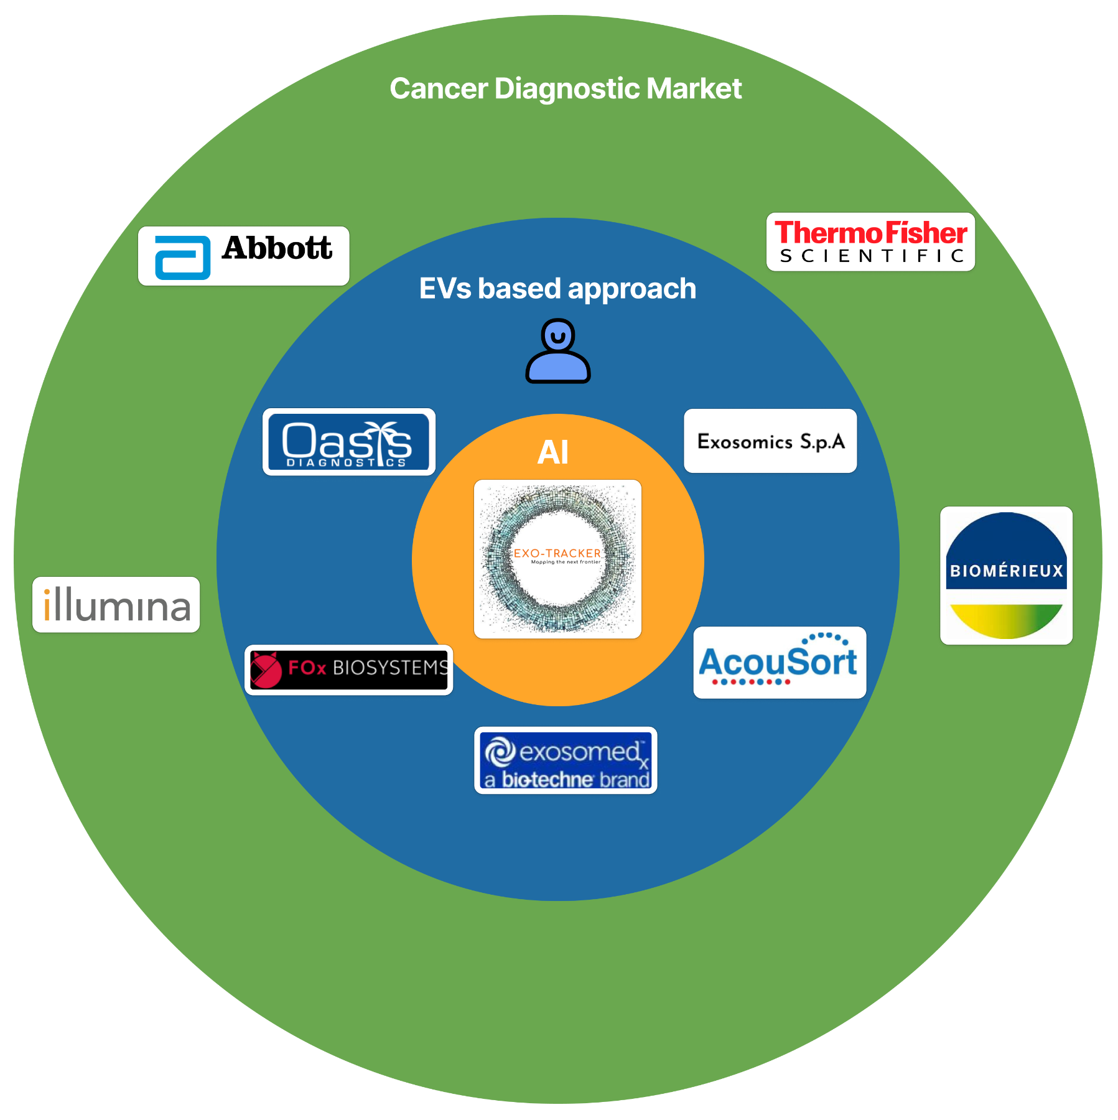

Exo-Tracker®
Competitor
I
II
III
IV
Global Market
(2024)
Largest Market
Size
102.16 B USD
USA
CAGR 5,20%
Global Market
(2029)
Fastest Growing Market Size
131.66 B USD
Asia/Pacific
Mordo Intelligence
FDA 21 CFR 809.3 : Overview of IVD Regulation | FDA
EU Regulation (2017/746)
2
Notes:
As an IVD product the current market was estimated at 102.18 B USD this year and is expected to reach 131.66B USD in 2029 with CAGR of 5,20% per year
Obviously the US market is the biggest, but the fastest growing one is currently Asia
Other data :
CAGR (Compound Annual Growth Rate) : 5,20% (between 2024-2029)
List of references :
EU Regulation (2017/746): REGULATION (EU) 2017/ 746 OF THE EUROPEAN PARLIAMENT AND OF THE COUNCIL - of 5 April 2017 - on in vitro diagnostic medical devices and repealing Directive 98/ 79/ EC and Commission Decision 2010/ 227/ EU Regulation (EU) 2017/746 of the European Parliament and of the Council, dated 5 April 2017, on in vitro diagnostic medical devices, repealing Directive 98/79/EC and Commission Decision 2010/227/EU.
FDA Regulation: Overview of IVD Regulation | FDA FDA 21 CFR 809.3, regarding in vitro diagnostic products (IVD).
Mordo Intelligence : Analyse de la taille et de la part du marché du diagnostic in vitro - Rapport de recherche de lindustrie - Tendances de croissance
Data Bridge Market Resarch : Taille Du Marché Des Diagnostics In Vitro (Div) , Demande Et Perspectives Futures D'Ici 2029

Slide 7


Exo-Tracker®
IP assets
Exo-Tracker®
IP assets
I
II
III
IV
I
II
III
IV
SOFTWARE
Data processing, Analysis & Classification of SERS signal
DATASET
Compiled EVs SERSs profiles, matched to associated clinical details
3
10 Best Practices for Artificial Intelligence Related Intellectual Property - Intellectual property Technology Law Journal
Notes:
SOFTWARE : The software used for data processing, analysis, and classification of exosome SERS signals
DATASET : Trade secret protection is the primary method for protecting datasets, particularly the confidential clinical information linked to the exosome profiles

Slide 8
Exo-Tracker®
Evaluating the Strategic Value of our IP
I
II
III
IV
I
II
III
IV
Software
Dataset
Competitive
Advantages
Market Differentiation
Model Training & Validation
Algorithm Refinement
Expansion of Application
10 Best Practices for Artificial Intelligence Related Intellectual Property - Intellectual property Technology Law Journal
Notes:
SOFTWARE :
Competitive Advantage: The software's ability to process, analyze, and classify exosome SERS signals is the core of the diagnostic system. Its accuracy, speed, and efficiency directly impact the system's effectiveness and market value.
Market Differentiation: A well-designed software package with user-friendly interfaces and robust functionalities can differentiate the business from competitors.
Expansion to Other Diseases: The modular nature of the software allows for the addition of diagnostic modules for other diseases, broadening the business's potential market and revenue sources.
DATASET:
Model Training and Validation: The curated datasets are essential for training and validating the AI models, ensuring high diagnostic accuracy.
Algorithm Refinement: The datasets enable continuous improvement and refinement of the algorithms, leading to better performance and potentially new discoveries

Slide 9
Exo-Tracker®
Protecting the assets
I
II
III
IV
I
II
III
IV
SOFTWARE
Copyright protection
DATASET
Trade Secret Protection
4
10 Best Practices for Artificial Intelligence Related Intellectual Property - Intellectual property Technology Law Journal
Notes:
SOFTWARE : Copyright protection is essential for the source code
DATASET : Trade secret protection is the primary method for protecting datasets, particularly the confidential clinical information linked to the exosome profiles

Slide 10









Exo-Tracker®
Our Target / Business model
I
II
III
IV
I
II
III
IV
Sale of Equipment or Analysis Kits
Software Licenses or Subscriptions
Saclay, EMBL Sorbonne, CNRS
Ipsen, Biomerieux, Innate Pharma
Consulting & Training Services
Partnerships
Hospitals, Clinics
5
Notes:
TARGET :
Research Laboratories and Universities: The tool can be highly valuable for researchers in the fields of cellular biology, biotechnology, and nanotechnology.
Pharmaceutical and Biopharmaceutical Industries: Companies developing innovative treatments, particularly in oncology, regenerative medicine, and gene therapy, may require advanced exosome analysis tools.
Biomarkers and Clinical Diagnostics: Companies specializing in molecular diagnostics and disease monitoring may be interested in precise tracking of exosomes as biomarkers.
BUSINESS MODEL :
Software Licenses or Subscriptions: Offer the platform through a SaaS (Software as a Service) model with monthly/annual subscription options tailored to the specific needs of users (e.g., researchers, large companies, hospitals).
Sale of Equipment or Analysis Kits: If the tool comes with laboratory equipment (e.g., for NTA analysis), the sale of specialized kits or equipment could represent a significant revenue source.
Consulting and Training Services: Provide training services for platform users, as well as technical support, data analysis services, or application customization.
Partnerships with Pharmaceutical Companies or Research Institutions: Collaborate with key industry players to use the platform in clinical studies or specific research on exosomes.

Slide 11
Exo-Tracker®
Roadmap
I
II
III
IV
6 - 8 months
1 - 3 years
1 - 2 years
4 - 5 years
X - X years
Reglementation
Financial step
Partnership
R&D + Data Gathering
Autorisation + Deployment
Requirement regarding the use of AI in research
Grants at European & National Scale
Participating to other hackathons
Business Angel & VC
Hospital/Clinic
Medical contacts + Team entourage
Institute
SERS machine
EVs processing method
SERS method development
AI Training
Notified organism + FDA
6

Slide 12
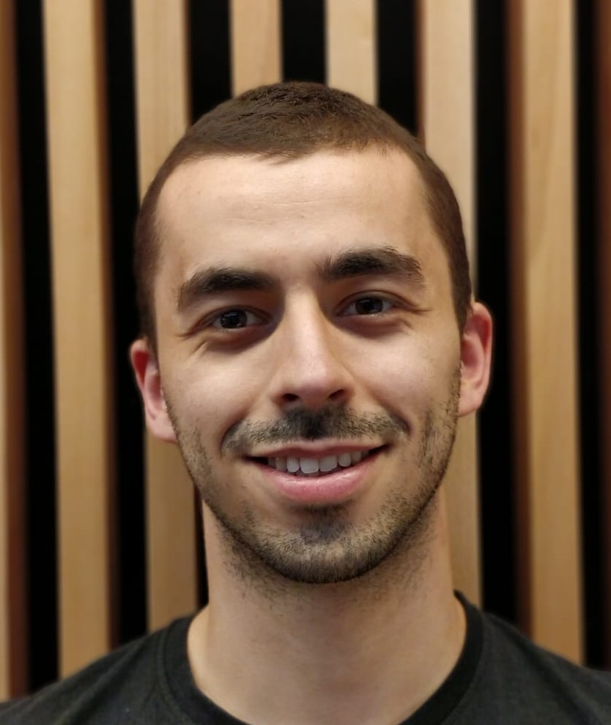
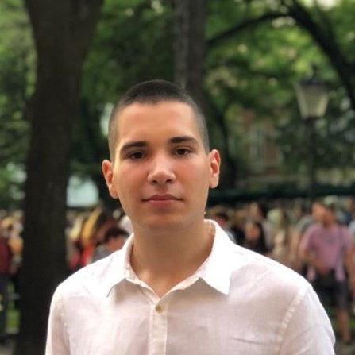

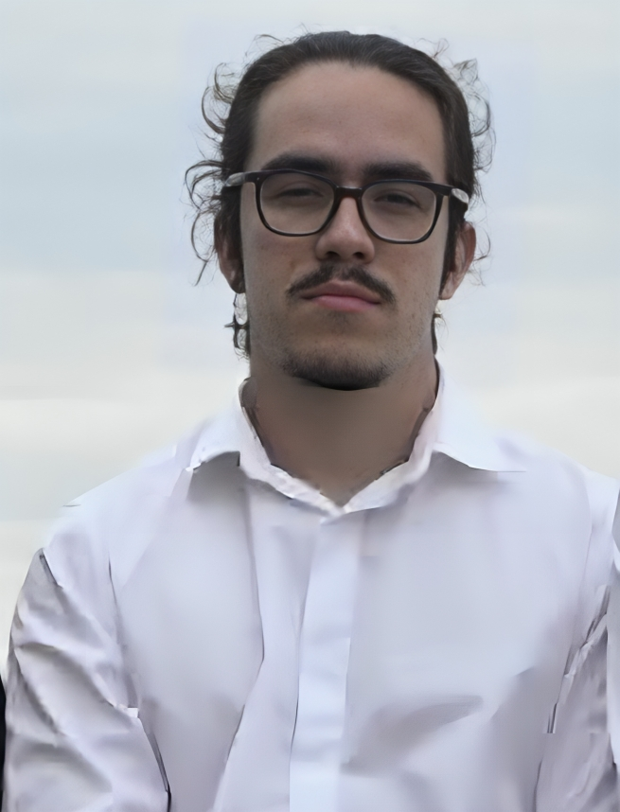







Meet the team
Exo-Trackers®
I
II
III
IV
MEDICAL DEPARTMENT
AI & TECH DEPARTMENT
Mehdi
Pharmacy Student
& Msc Biotechnologist
Nihad
Pharmacy Student & Engineer
Mijat
Software Engineering Student
Tolga
Msc in AI & Deep Learning
Victor
Computer Science Student
Experienced in therapeutic & diagnostic applications of EVs
Experience in cells culture and biotechnological production
Experienced in computer science, interested in its applications in medicine
Interested in medical applications of AI
GPS (General Problem Solver)

Slide 13

Exo-Tracker
Demo
I
II
III
IV
Shin H, et al – Nat Commun (2023)
Notes:
This shows the reproduction of the code provided by the research paper:
Shin H, Choi BH, Shim O, Kim J, Park Y, Cho SK, Kim HK, Choi Y. Single test-based diagnosis of multiple cancer types using Exosome-SERS-AI for early stage cancers. Nat Commun. 2023 Mar 24;14(1):1644. doi: 10.1038/s41467-023-37403-1. PMID: 36964142; PMCID: PMC10039041.
The code behind the demo belongs to these authors.
For briefly sake, we forced the stop on the inference demo.

Slide 14
Thank you for your attention !!
For more details, networking recommendations, or possible collaborations.
Contacts :
exo.tracker@gmail.com

Slide 15

SERS
High-Level Explanation
SERS : Surface-Enhanced Raman Spectroscopy
Fit for biodetection
Provides molecular information fingerprint
New “iteration” of Raman spectroscopy(RS)
Addresses shortcomings of RS :
Limited cross section (10-30cm²/molecule)
Sensitivity to fluorescence interference
SERS features :
non-destructive
non-invasive
repeatable
Good fit detection of EVs
Label-free or Immunolabeling modus
Notes:
Stands for: Surface-Enhanced Raman Spectroscopy
It can be seen as a new iteration of the Raman spectroscopy(RS) technique. It is a technology suitable for the detection of biochemical substances. Indeed, it provides a molecular information fingerprints..
It has the following features: non-destructive, non-invasive, repeatable.
SERS, from a high-level perspective, it addresses the shortcomings of RS: limited cross section and sensitivity to fluorescence interference => limits its wide application.
SERS enhancements come from a chemical and physical enhancements. It combines light and nanoparticles such as gold to increase the surface plasmon resonance effect and pronounce the sensitivity of the fingerprints.
It is a nice fit for detecting EVs such as exosomes. The data gathering can be done in label-free or immunolabeling approach.
https://www.frontiersin.org/journals/bioengineering-and-biotechnology/articles/10.3389/fbioe.2021.808933/full

Slide 16
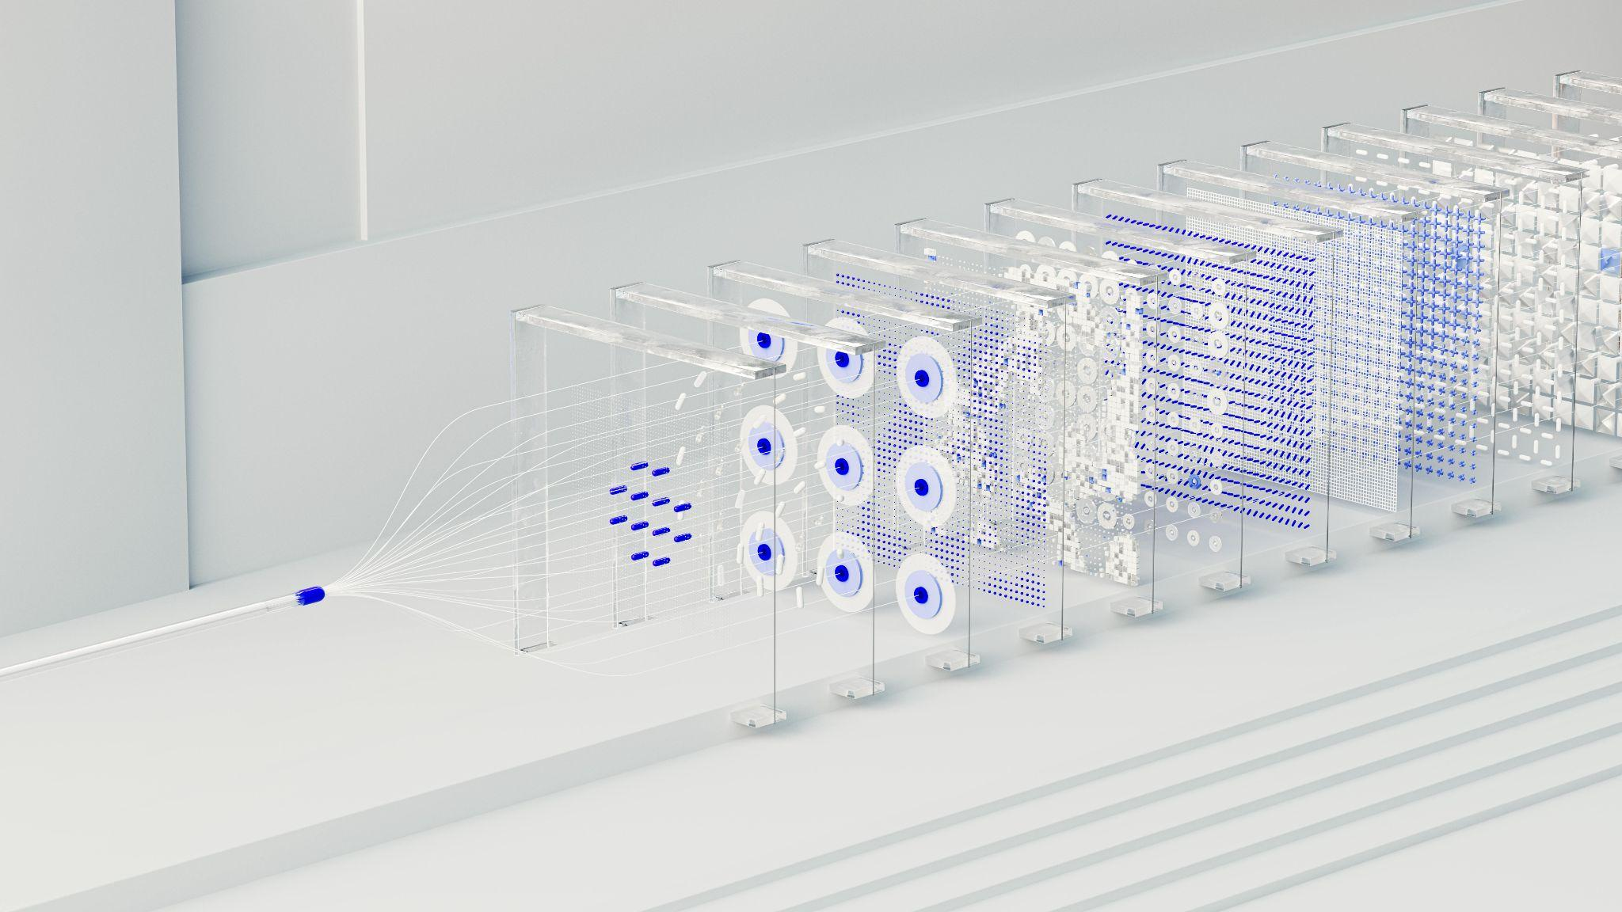
Machine Learning / Deep Learning
Model Architecture Considerations
We mainly observe the use of Artificial Neural Networks (ANNs):
Convolutional Neural Networks - CNN
With FCN (Fully Connected Layers)
ReLU AF (Activation Function)
Training using Batch Normalization (BN)
Dropout for regularization
Softmax for Multi-Classification
Use of ResNets (Deep Residual Networks)
Powerful and Efficient architecture for CV
Data
Source: SERS
Point of Interest: Raw Data “shape/form”
Filtering/Preprocessing/ETL steps
Improve inference time
Notes:
Based on the preliminary literature review that we were able to conduct so far. Here are some of the technical aspects that we can present.
We observe 1) the use of ANNs in the following declinations: CNNs with some using FCN.
Training is conducted using ReLU(Rectifier Linear Unit) BN(Batch Normalization), dropout, softmax for multi classification. In other words, “standard” stuff in ML/DL world.
2) The use of a research-based architecture i.e.: ResNets. It is widely known and efficient DL architecture in the field of CV(Computer Vision).
The source of the data for the ML/DL pipeline comes from the Surface-Enhanced Raman Spectroscopy device/process.
=> Need to investigate the raw data. In other words, apply some filtering/preprocessing/transformation or ETL(Extraction, Transformation and Load) in ML parlance.
With the objective to(hopefully) confirm the results from the Shin H et al. Single test-based diagnosis of multiple cancer types using Exosome-SERS-AI for early stage cancers. Nat Commun. 2023 Mar 24 paper
Another axis of improvement: working on reducing the latency of inference time.
List of references :

Slide 17
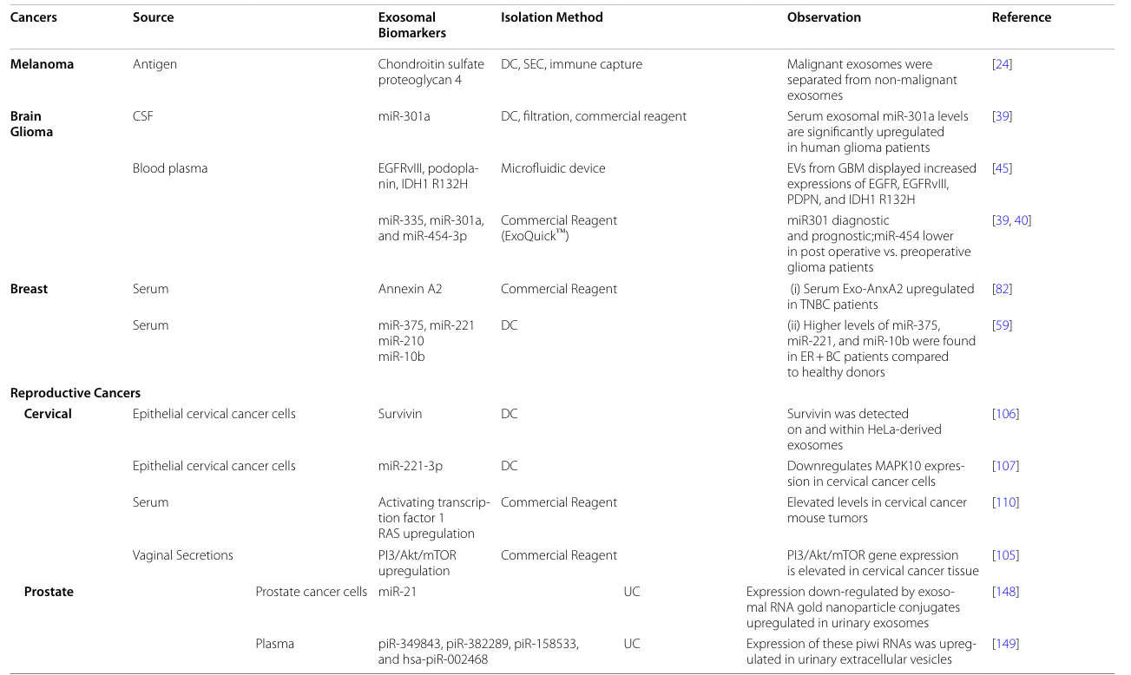
Other applications
Oncology
Notes:
List of references :
Andre M, Caobi A, Miles JS, Vashist A, Ruiz MA, Raymond AD. Diagnostic potential of exosomal extracellular vesicles in oncology. BMC Cancer. 2024 Mar 8;24(1):322. doi: 10.1186/s12885-024-11819-4. PMID: 38454346; PMCID: PMC10921614.

